Slide 1
Amida Case Study
November 8th, 2021
Adam Keefe

Slide 2
Part 1: Manipulating Data
Assigning Column Headers Programmatically
Read txt file of attributes in as csv, colon [:] as separator
Store first column of imported txt file as “headers”
Import adult.csv as normal, but assign column names property with headers as array.
Replacing Dashes with Spaces in Native country names
swapped ‘native-country column values string ‘-’ values with via “df['native-country'].str.replace('-',’ ‘)”

Slide 3
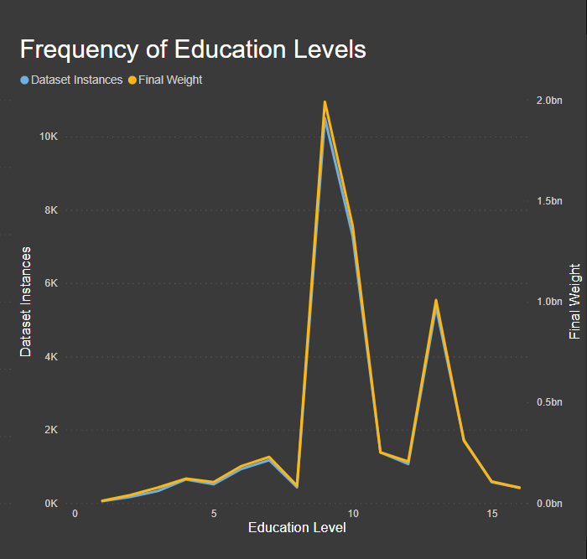
Part 2.1: Missing Data
Missing numerical data is represented as ‘0’ in capital-gain and capital-loss—with the majority set to ‘0’ on these.
Missing string fields were represented as ‘?’ for string fields in workclass, occupation, and native-country, with 1836, 1843, and 583 unknown instances of each, respectively, out of a total 32560 rows.
I am opting to not examine capital-gains and capital-loss here, and disregarding the fnlweight column, as it seems to follow the same general distribution as the sample dataset

Slide 4
Part 2.2: Explanatory Statistics
Quantile:
Mode:
Mean:
age | 37
fnlwgt | 178356
education-num | 10
capital-gain | 0
capital-loss | 0
hours-per-week | 40
age | 36
workclass | Private
fnlwgt | 123011
education | HS-grad
education-num | 9
marital-status | Married-civ-spouse
occupation | Prof-specialty
relationship | Husband
race | White
sex | Male
capital-gain | 0
capital-loss | 0
hours-per-week | 40
native-country | United States
income | <=50K
age | 38.58165
fnlwgt | 189778.4
education-num | 10.08068
capital-gain | 1077.649
capital-loss | 87.30383
hours-per-week | 40.43746

Slide 5
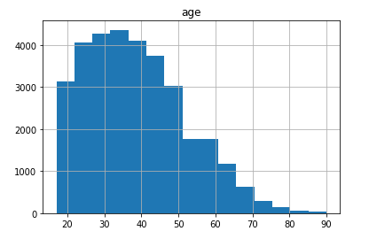
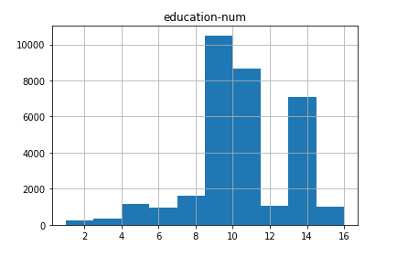
Part 2.2: Explanatory Statistics
Age:
Education Level:

Slide 6
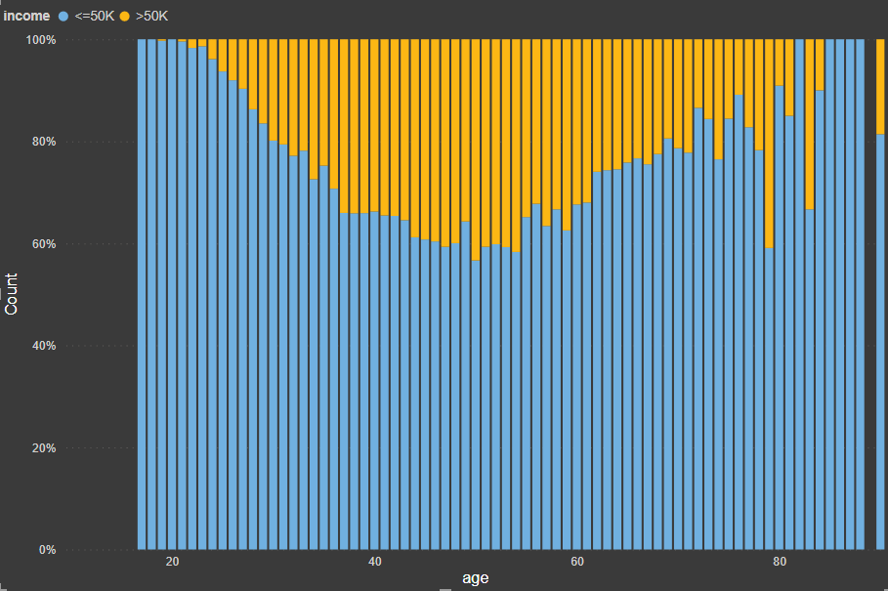
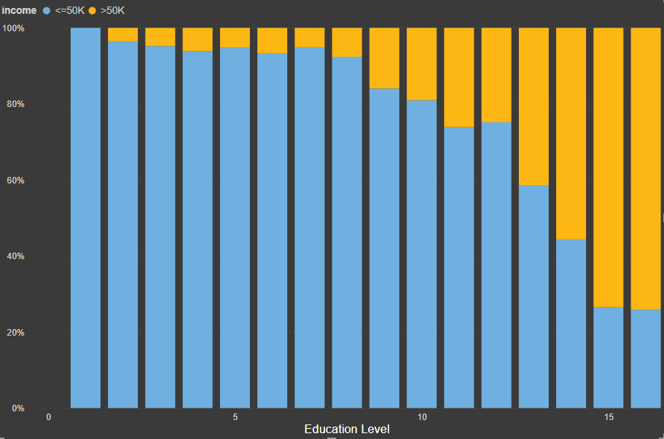
Part 2.3: Visualizations
Age:
Education Level:

